Slide 1
Capstone Project – Passenger Satisfaction
Siu Tim Jun

Slide 2
Introduction
Evaluate the significance of factors to the overall satisfaction of the flight experience
Provide insight for airlines companies on how to provide better experience to the customers efficiently

Slide 3
Data
104,000 rows
24 columns
Background information of the passengers
Satisfaction level on different aspects
Overall satisfaction level

Slide 4
Data Preparation
Drop ID column
Overall satisfaction level will be changed into dummy variable
"satisfied" → True
"neutral or dissatisfied" → False.

Slide 5

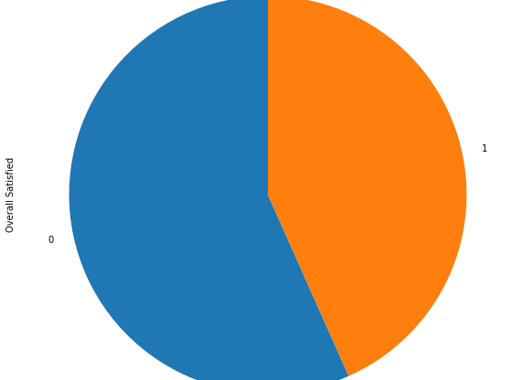
Data Evaluation
Quite balanced labeled dataset

Slide 6
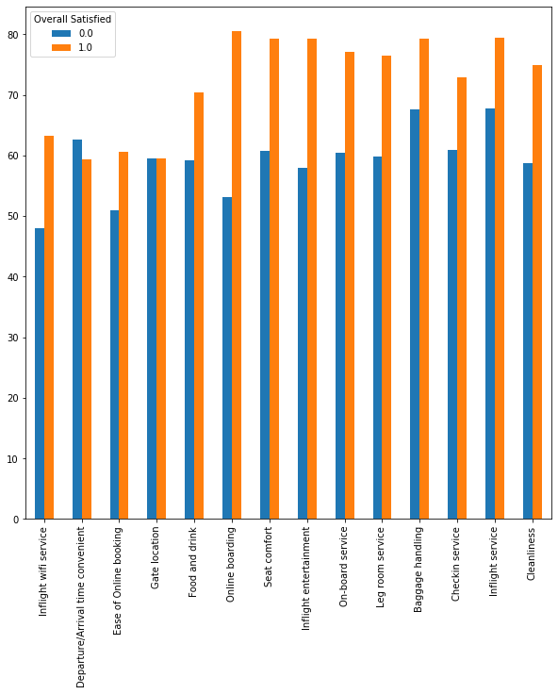
Single Factor Analysis
Satisfaction levels become percentages
Online booking, inflight entertainment and seat comfort would greatly affect the overall satisfaction level
Departure / arrival time convenient and gate location does not really affect the overall satisfaction level

Slide 7
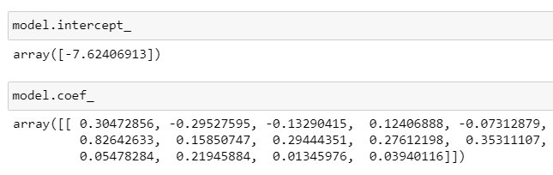
Multiple Factors Analysis - Logistic Regression
Most significant factors:
online boarding
leg room service
inflight wifi service

Slide 8
Conclusion
Airline company should focus on online boarding service, leg room service, inflight wifi service, inflight entertainment and seat comfort
Upgrade the interface of online boarding service to be more user-friendly
Update the inflight entertainment so that new movies and TV shows can be watched in the plane
Provide wifi service for more passengers to access

